Slide 1
NCFE Level 2 Data Analysis
Drinks Sales
Data Analysis
An exploration of sales performance across brands, flavours and markets
61,458 Total Units £92,699 Total Revenue 2 Brands 6 Markets 8 Flavours

Slide 2
Data Cleaning
Errors found & corrected before analysis
Brand Typo
Flavour Abbreviation
'Coke' entered instead of 'Cola'
'Fruity' entered instead of 'Fruit'
=ARRAYFORMULA(IFS(A2:A="Coke", "Cola", A2:A="Fruity", "Fruit", TRUE, A2:A))
'Che' used instead of 'Cherry'
'Lem' used instead of 'Lemon'
=ARRAYFORMULA(IFS(B2:B="Che", "Cherry", B2:B="Lem", "Lemon", TRUE, B2:B))
✔ Corrected to 'Cola' and 'Fruit'
✔ Expanded to full flavour names
Market Inconsistency
Data Types
'United Kingdom' and 'UK' used
for the same market
=ARRAYFORMULA(IFS(C2:C="United Kingdom", "UK", TRUE, C2:C))
Units Sold stored as text
Unit Cost stored as text
✔ Standardised to 'UK' throughout
✔ Converted to numbers for calculations
4 data quality issues resolved • Dataset ready for analysis
Notes:
Moving into the data preparation phase, I identified several inconsistencies in the raw dataset that would have compromised the accuracy of my final analysis. Specifically, the 'Market' column used both 'United Kingdom' and 'UK' interchangeably.
Instead of performing a manual 'Find and Replace', which is prone to human error and isn't repeatable, I implemented the ARRAYFORMULA seen here. I chose this approach for three key reasons:
First, Scalability: By using the range C2:C, this formula automatically applies the logic to every new row added to the sheet. This creates a 'dynamic' cleaning process that grows with the dataset.
Second, Data Integrity: I utilized a nested IFS statement. By setting the final argument to TRUE, C2:C, I created a 'catch-all'. This ensures that while 'United Kingdom' is corrected to 'UK', all other valid markets—like France or Germany—remain untouched and preserved.
Third, Standardisation: Standardising to the shorter 'UK' string ensures that my downstream visualisations, such as bar charts and pivot tables, remain clean and professional without duplicate categories.
By establishing this 'single source of truth' at the cleaning stage, I ensured that the trends and patterns I'll discuss in the next few slides are based on 100% validated data.

Slide 3
Key Statistics at a Glance
61,458
£92,699
£1.52
Total Units Sold
Total Revenue
Avg. Unit Cost
Across all brands, flavours & markets
Combined revenue from all sales
Average price across all products
Spain
Cherry
Cola
Top Market
Best-Selling Flavour
Leading Brand
Highest revenue — £18,510
9,302 units sold in total
52.7% of total units sold

Slide 4
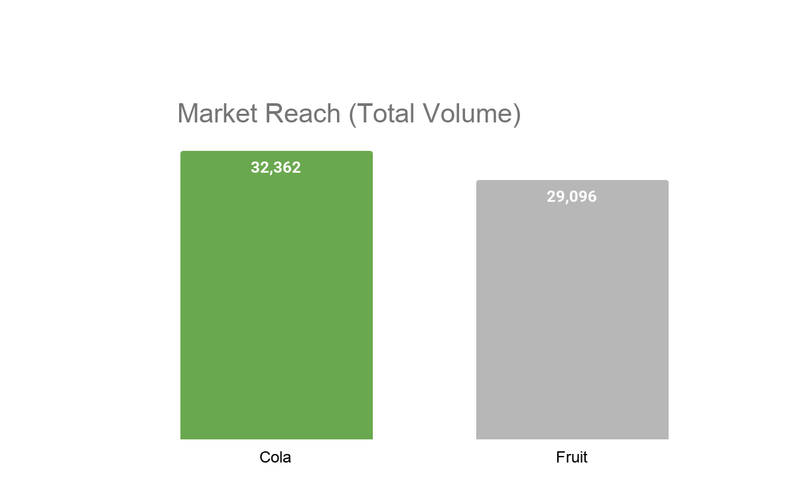
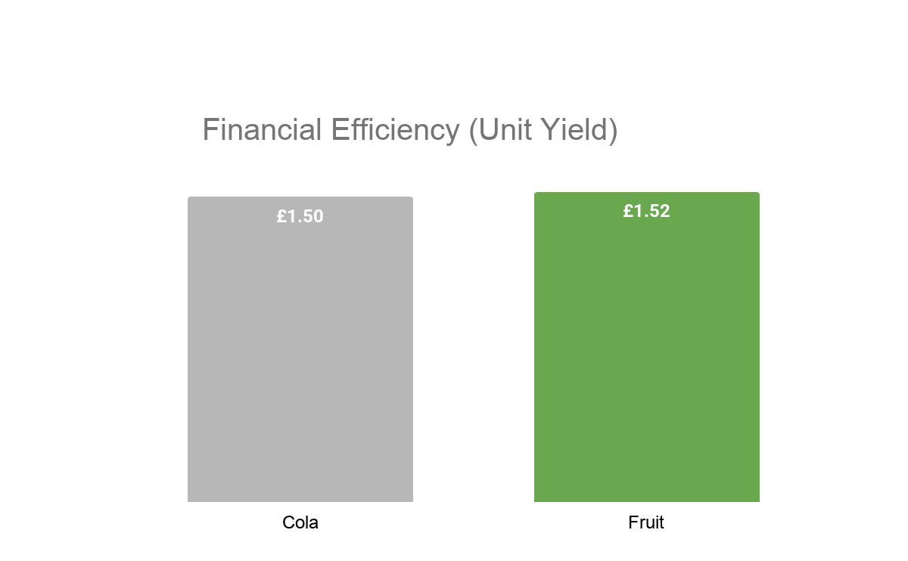
Brand Performance: Cola vs Fruit
Key Insights
The Volume Engine: Brand Cola is the primary driver of market presence, outperforming the Fruit range by 3,266 units. This high volume results in a total revenue contribution of £48,415.37.
Yield Efficiency: While lower in volume, Brand Fruit achieves a superior "True Yield" of £1.52 per unit. This makes it the most margin-efficient product line in the portfolio.
Pricing Strategy: The business maintains a near-uniform pricing model across both brands. The £0.02 yield advantage held by the Fruit range suggests a slightly more premium price-point or lower discount frequency compared to Cola.
Revenue Impact: Combined, the two brands generate a total revenue of £92,699.42, with Cola accounting for 52% of that total due to its sales velocity.
💡 Cola outsells Fruit by ~3,000 units and generates ~£4,100 more revenue — Cola is the dominant brand in the portfolio.
Notes:
This slide provides a macro-view of our two primary brands. What we see here is a classic 'Volume vs. Efficiency' trade-off.
Brand Cola is our powerhouse; it moves the most units and brings in the most total cash. However, our manual yield analysis reveals that Brand Fruit is actually more efficient, earning £1.52 for every bottle sold compared to Cola’s £1.50.
While the simple average unit price across the portfolio is £1.52, a weighted average analysis (Total Revenue / Total Volume) reveals that the Fruit range achieves a higher true yield (£1.52) than the Cola range (£1.50).
This means that while Cola is our current leader, there is a significant opportunity to grow our total profit if we can apply Cola's high sales volume to the more efficient Fruit portfolio

Slide 5
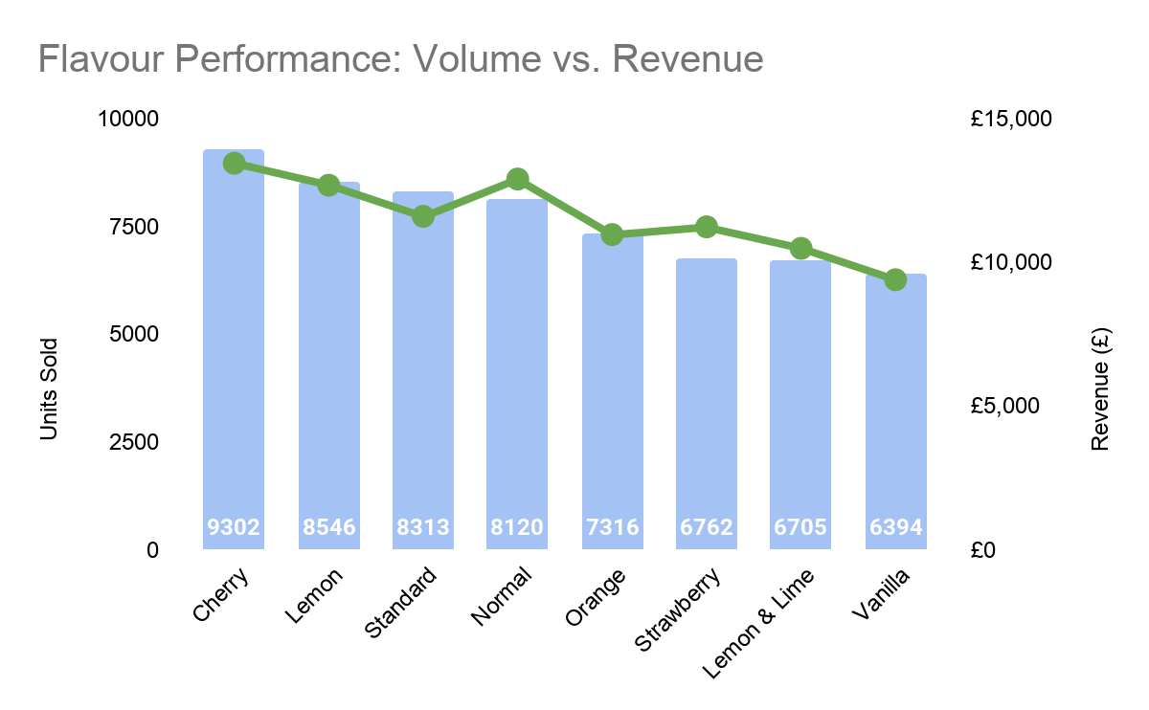
Strategic Analysis: Brand Flavours
Key Insights The Hero Product: Cherry (Brand Cola) is the undisputed market leader, achieving the highest volume (9,302 units) and revenue (£13,445.17). It serves as the primary anchor for the entire product portfolio.
Revenue Efficiency Anomaly: A critical distinction exists between Normal (Brand Cola) and Standard (Brand Fruit):
Standard moves 193 more units than Normal.
However, Normal generates £1,296 more in revenue.
Brand Tiering Impact: This confirms a price premium for the Cola brand. Brand Cola flavours (Normal, Cherry, Lemon, Vanilla) consistently show a higher "Revenue-to-Volume" ratio compared to the Fruit brand.
Notes:
This analysis correlates unit volume against total revenue across two distinct product lines: Brand Cola and Brand Fruit . The data reveals that while fruit-based flavours drive market reach, the cola-based portfolio delivers superior financial returns per unit sold. Key Insights – Strategic Observations
Brand Cola (Value Driver): These flavours are the "Margin Leaders." Even lower-volume variants like Vanilla maintain a relatively high revenue line, suggesting high brand loyalty and price inelasticity.
Brand Fruit (Volume Driver): This line (Standard, Orange, Strawberry, Lemon & Lime) is positioned as a mass-market offering. While essential for overall market share, these flavours operate on lower unit margins.
Growth Recommendation: To maximise profitability, marketing efforts should focus on the Brand Cola range, specifically leveraging the success of Cherry to "halo" the other premium cola variants.

Slide 6
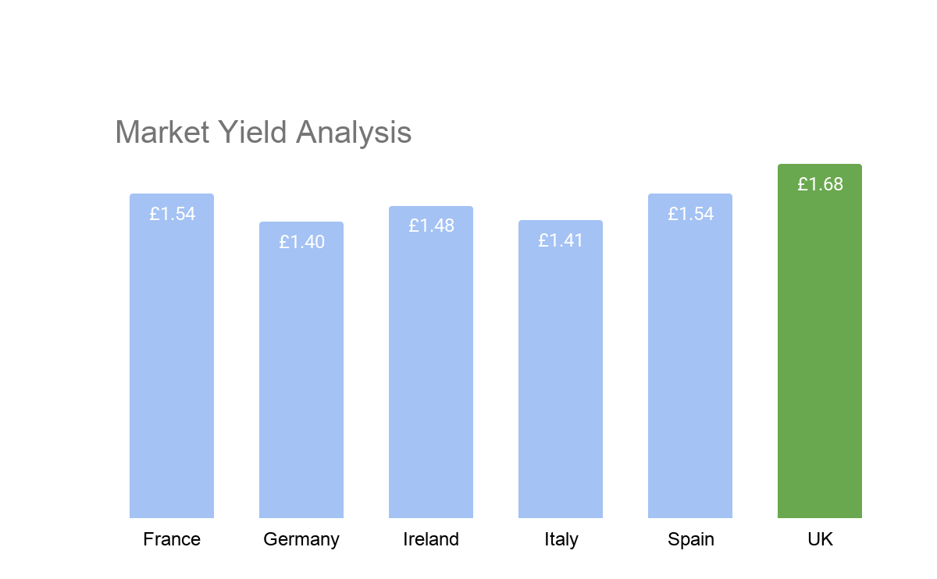
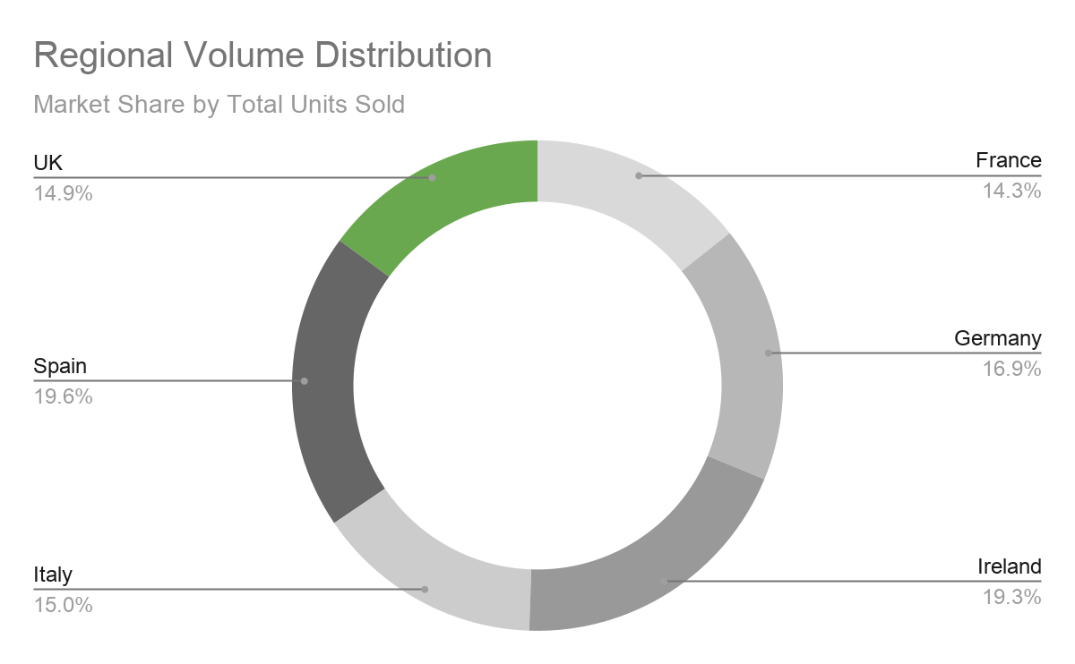
Market Analysis: Volume vs. Unit Value
Key Insights
Volume Dominance: Spain and Ireland are the primary drivers of sales volume, together representing 39% of total units sold. They are the essential mass market foundations of the business.
The UK Price Premium: Despite being a mid-tier volume market, the UK achieves the highest Average Unit Price at £1.68.
Yield Efficiency: The UK generates significantly more revenue per unit than Germany (£1.40) or Italy (£1.41). This identifies the UK as the most efficient market in terms of financial return.
Brand Correlation: This regional success in the UK directly correlates with the high performance of the Brand Cola portfolio (Normal, Cherry, Vanilla) identified in our previous flavour analysis.
Notes:
This analysis evaluates the global footprint of the product portfolio by comparing total sales volume against regional unit yield.
While Spain and Ireland act as the primary engines for market reach—contributing our highest unit volumes—the UK distinguishes itself as the most profitable territory per transaction. The data suggests a clear correlation between the UK's high Average Unit Price (£1.68) and the successful penetration of the premium Brand Cola range.
This highlights a proven model for high-margin growth that could be replicated in lower-yield regions such as Germany and Italy.
Strat insight - To increase profitability in high-volume but lower-yield markets like Germany and Italy, the business should pivot its marketing strategy toward the premium Brand Cola range, mirroring the successful high-margin model established in the UK.

Slide 7
Top Performing Products
Rank | Brand | Flavour | Market | Units Sold | Unit Cost | Revenue (£)
🥇 1 | Cola | Normal | Spain | 1,945 | £1.92 | £3,734
🥈 2 | Cola | Cherry | Ireland | 1,832 | £1.83 | £3,353
🥉 3 | Fruit | Standard | UK | 1,680 | £1.81 | £3,041
4 | Cola | Lemon | Ireland | 1,790 | £1.69 | £3,025
5 | Fruit | Strawberry | UK | 1,512 | £1.99 | £3,009
💡 Three of the top 5 products are Cola-based. Spain & Ireland are the standout markets for top-revenue products.
Notes:
Moving from our high-level brand and regional overviews, this slide identifies the 'Top 5' individual product-market combinations. By drilling down into this data, we can identify exactly which specific products are generating our highest returns.
The Leadership of Normal Cola: The top spot is held by Normal Cola in Spain, which generated £3,734. This is a significant finding because it achieves this lead while maintaining a premium unit cost of £1.92. It proves that in the right market, our consumers are not price-sensitive and will pay a premium for a core product.
Regional Strength: Ireland and the UK: We see a strong showing from Ireland, with both Cherry and Lemon Cola appearing in the top four. Together, these two products alone contribute over £6,300 in revenue. Additionally, the presence of Standard and Strawberry Fruit in the UK highlights that our Fruit brand achieves its best financial performance through high-volume sales in the British market.
The 'Cola' Dominance (Lightbulb Insight): As highlighted by the insight at the bottom of the slide, three of our top five revenue earners are Cola-based products. This further reinforces the brand's position as the 'profit engine' of the portfolio.
Strategic Takeaway: These top five products alone account for a disproportionate amount of our total revenue. Strategically, this confirms that our growth is currently driven by a concentrated group of 'Hero' products. Future expansion should look to replicate the success of these specific SKU-Market pairings in our other territories.

Slide 8
Key Insights & Conclusions
01
Cola is the Market Leader
The brand Cola acts as the portfolio's primary volume driver, securing 52.7% of all units sold and 52.2% of total revenue. This indicates a strong consumer preference for the Cola-based range, marking it as the “low-risk” anchor for future product launches.
02
Spain & Ireland Drive Revenue
Spain (£18,510) and Ireland (£17,606) are the top two markets, contributing 39% of total revenue despite representing 33% of the regional footprint. These markets are the growth engines of the business and success here should be used as a blueprint for scaling underperforming regions like Italy.
03
Cherry is the Most Popular Flavour
Cherry leads all individual flavours with 9,302 units (£13.4k revenue). In contrast, Vanilla shows the lowest engagement. Cherry is a hero product. Resources should be shifted from Vanilla toward Cherry-based marketing to capitalise on existing momentum.
04
Price Does Not Always Drive Volume
Normal Cola in Spain achieves the highest single-product revenue (£3,734) at a premium price of £1.92. This shows that there is price elasticity within the portfolio, meaning customers are willing to pay more for the right product in the right market, justifying higher margins elsewhere.
NCFE Level 2 Data Analysis • Dataset: 48 cleaned records • 6 countries • 2 brands • 8 flavours
Notes:
Introduction
To conclude our analysis, I have synthesised our findings into four strategic pillars that define the current health and future direction of the product portfolio. These insights move us beyond raw data and into actionable business strategy.
1. Portfolio Anchor: Brand Cola
Firstly, the data confirms Brand Cola as our primary market anchor. It accounts for 52.7% of all units sold and generates over half of our total revenue. This is a critical finding because it proves that the Cola range has the strongest 'consumer pull' and should remain the focus of our core marketing spend.
2. Regional Powerhouses: Spain & Ireland
Geographically, our revenue is highly concentrated. Spain and Ireland are our standout performers, contributing nearly 40% of our total turnover despite representing only two of our six active markets. This suggests that our brand resonance is highest in these regions, providing a perfect 'blueprint' for how we might scale operations in Italy and Germany.
3. Product Hero:
At the flavour level, Cherry is our undisputed 'Hero Product,' leading the portfolio with over 9,300 units sold. Conversely, the weaker performance of Vanilla suggests that we are currently over-invested in a low-engagement flavour. My recommendation here is to reallocate promotional resources from Vanilla toward Cherry to further capitalise on its existing momentum.
4. Pricing Power: The Spain Case Study
Finally, we have debunked the idea that higher prices naturally lead to lower volumes. In Spain, our Normal Cola achieved the highest single-product revenue at a premium price of £1.92. This proves that 'Price Elasticity' exists in our portfolio; when the market conditions and product-fit are right, customers are willing to pay a premium. This justifies a shift toward higher-margin strategies across our other territories.
The Final Verdict
In summary: the business is currently driven by a high-volume Cola core and high-yield regional pockets. Our path to growth isn't necessarily about finding new customers, but about replicating the £1.92 premium model and the Cherry flavour success across our entire geographic footprint. Thank you for your time.

